Slide 1

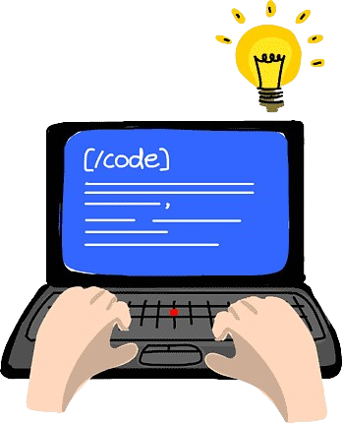
Sailing The Sea Of C
Last Session
Doubt Solving Session
PYQ’s Solutions

Slide 2
Topics Which We Covered
Day 1 Session 1
- Block Diagram Of Computer,
- C Language Basics And History
- Syntax - Printf, Scanf,
Keywords,
Data Types,
Variables,
Operators (7 types),
type casting
Area of circle,
Fahrenheit to Celsius Convertor

Slide 3
Topics Which We Covered
Day 1 Session 2
Control Structure(if Else, Nested If, Switch)
Adult , Young Code
Pass - Fail Code
Even Odd Code
Leap Year Check
Print N Numbers,
Sum Of First N Numbers,
Condition In Loop,
Prime Numbers,
Fibonacci Series
Sum Of All Digits In Number
Reverse Number

Slide 4
Topics Which We Covered
Day 1 Session 3
Patterns
Start Rectangle
Number Rectangle
Start Triangle
Number Triangle
Alphabet Triangle
Floyed Triangle
Hollow Rectangle

Slide 5
Topics Which We Covered
Day 2 Session 1
1-D Array Basics
Array Problems
Sum Of All Elements ,
Find Maximum,
Sort Array,
Reverse Array
Check Palindrome

Slide 6
Topics Which We Covered
Day 2 Session 2
2-D Array basics
searching element
maximum element
sum of two matrix
multiplication of two Matrices
String
String initialization
String methods
Palindrome Check

Slide 7
Topics Which We Covered
Day 2 Session 3
Recursion
Print N Numbers
Factorial
Fibonacci Series
Power Of A Number
Functions
Call By Value, Reference
Swap Two Numbers

Slide 8
Topics Which We Covered
Day 3 Session 1 & 2
Pointer
Structure
File Management
Dynamic Memory Allocations

Slide 9


Ask us your Doubts…??
If you don’t have any doubts then I have many doubts..!!!

